Slide 1

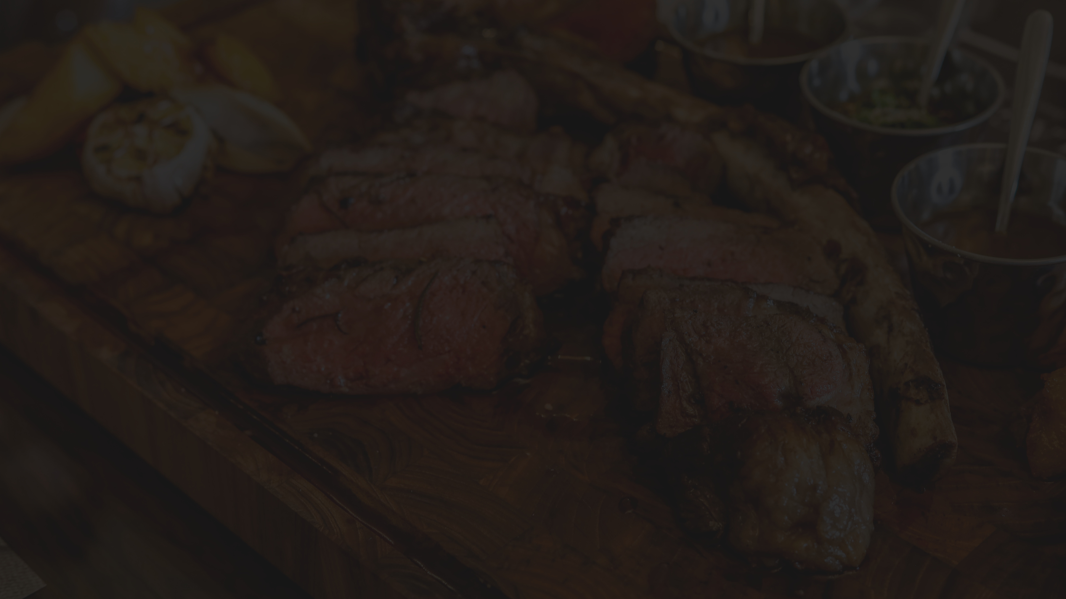



RESTAURANT WEBSITE
FOOD'S CODE
Submitted By:
Ananya Jain (20BCS2444)
Shivam Raj (20BCS2386)
Arkesh Bhargava (20BCS2429)
Shivam Khanna (20BCS2401)

Slide 2
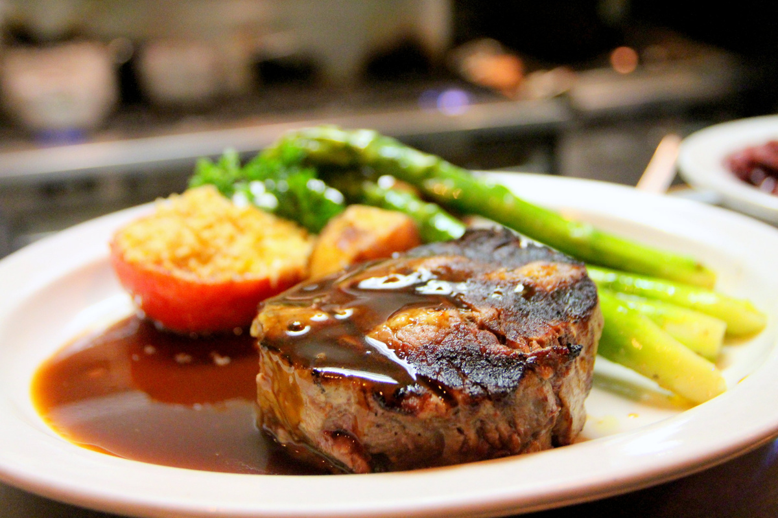


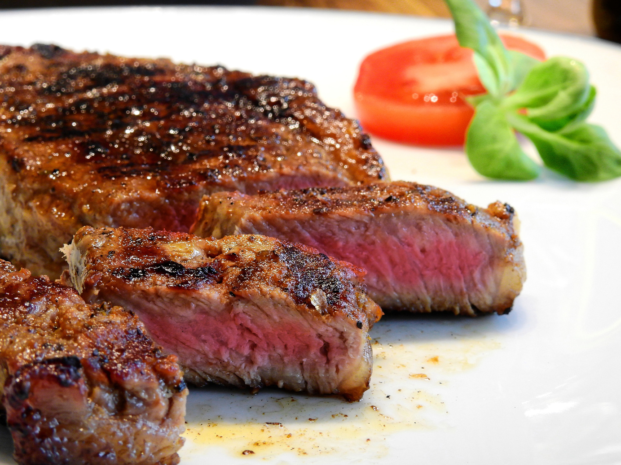
INDEX
Introduction
Objectives
Technology Used
Diagrams
Screenshots
Outcomes

Slide 3

INTRODUCTION
It is a restraunt website. This will help the restraunt to keep records.
A customer can book their dine-in in advance. In this way it can help in reducing the hustle after visiting the restraunt.
LEARN MORE

Slide 4

OBJECTIVE
Customers can hava a detailed information about the restraunt before visiting it. They can explore the menu and book table preferences according to them.
They can directly contact us and ask about their queries and can receive important updates too.
This website can help the restraunt to operate hustle free.
LEARN MORE

Slide 5

TECHNOLOGY
USED
For Frontend, we have used HTML, CSS and JavaScript.
For Backend, we have used PHP, XAMPP and My SQL.
LEARN MORE

Slide 6
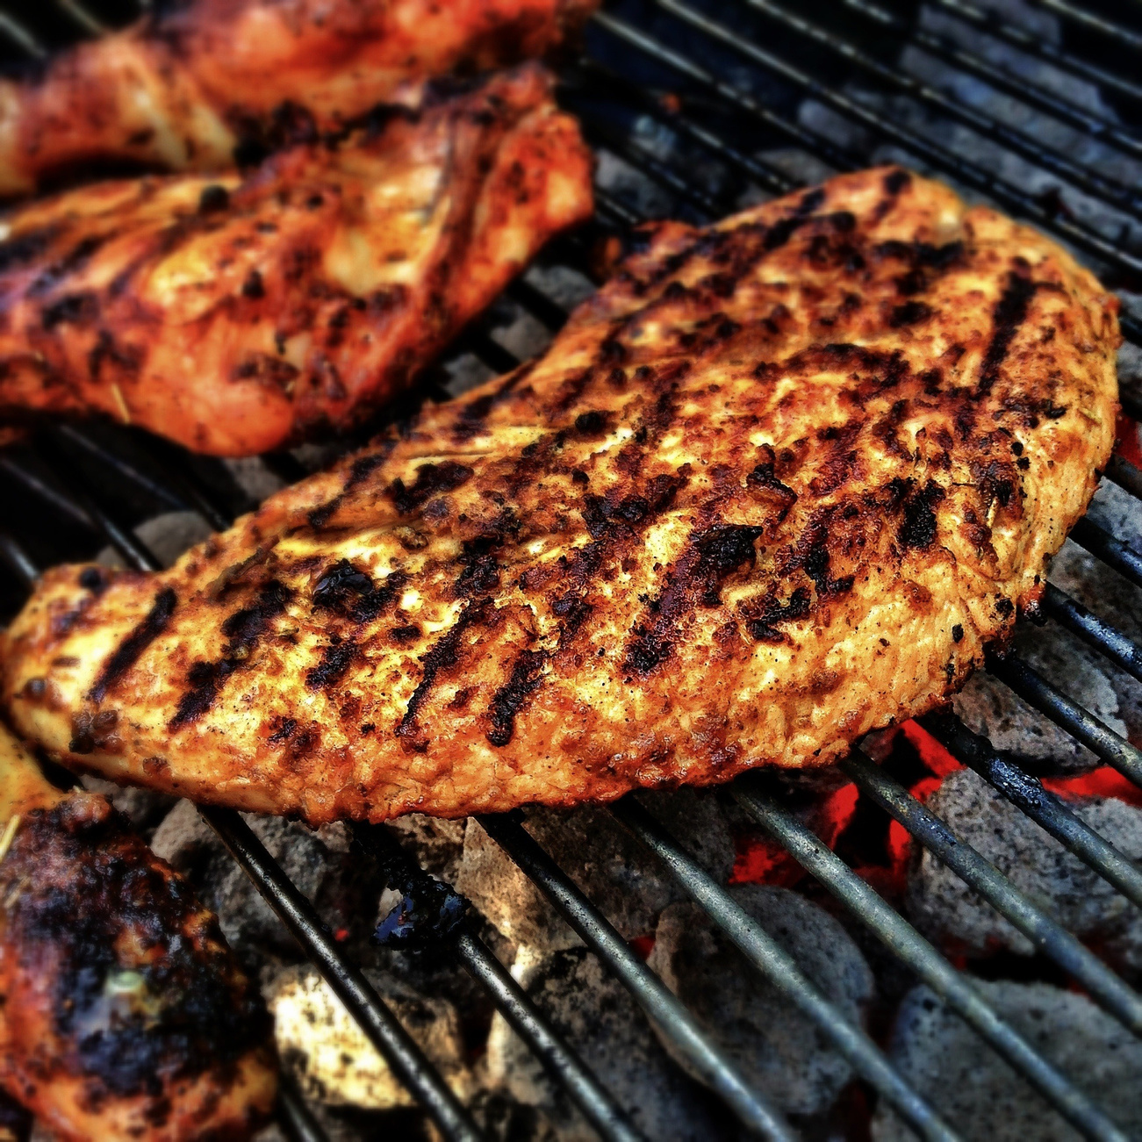
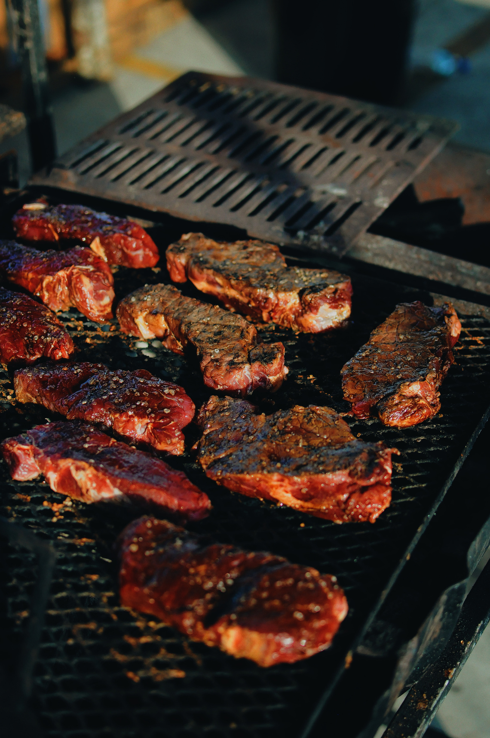
HARDWARE REQUIREMENTS
1
Processor (CPU) with 2 gigahertz (GHz) frequency or above
2
A minimum of 2 GB of RAM
3
Broadband (high-speed) Internet connection with a speed of 4 Mbps
4
Network Interface Card
5
Upto 4GB of internal storage
LEARN MORE

Slide 7
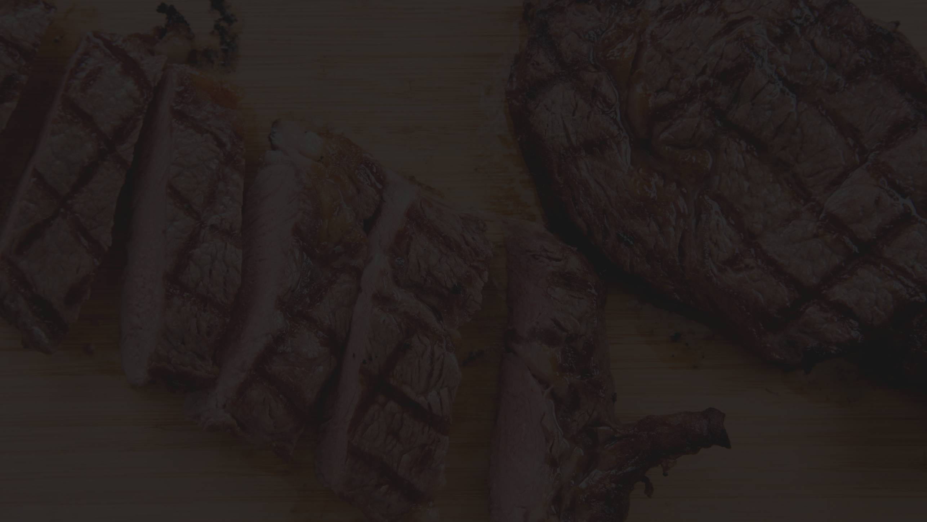

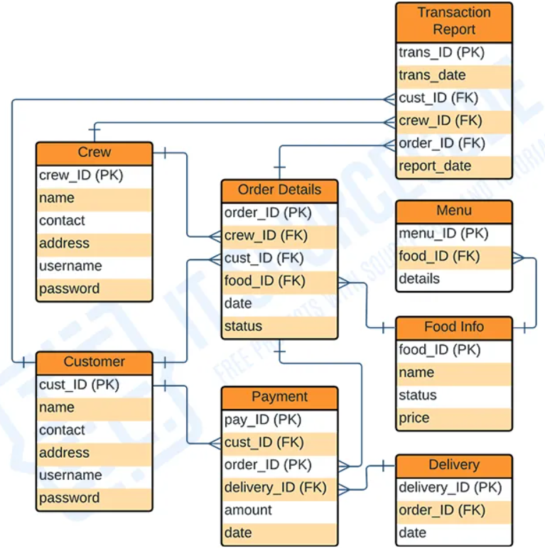
ER DIAGRAM
LEARN MORE

Slide 8

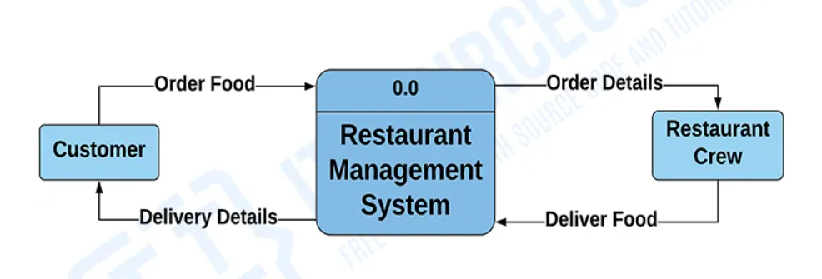
DATA FLOW DIAGRAM
Level 0
LEARN MORE

Slide 9
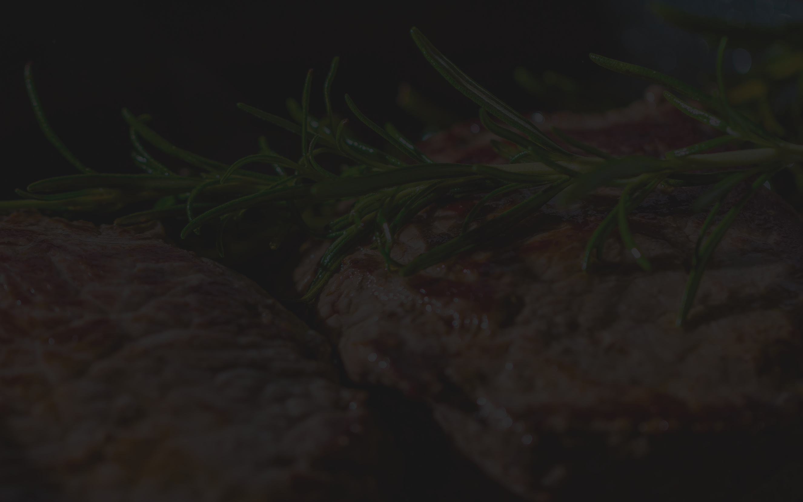
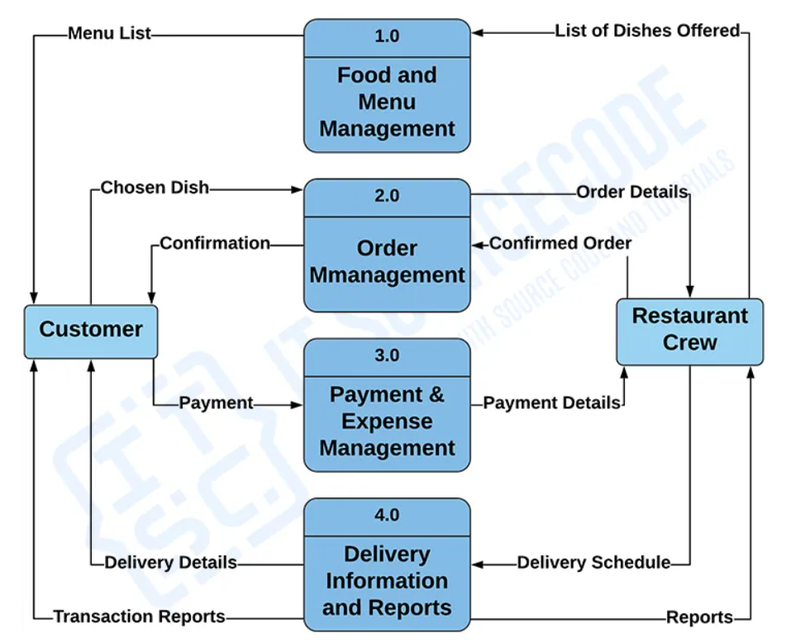
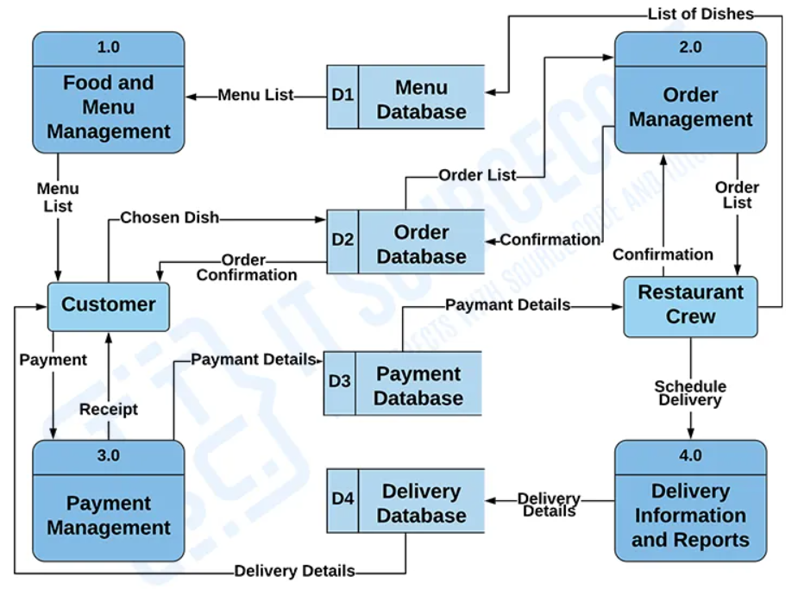
Level 1
Level 2
LEARN MORE

Slide 10

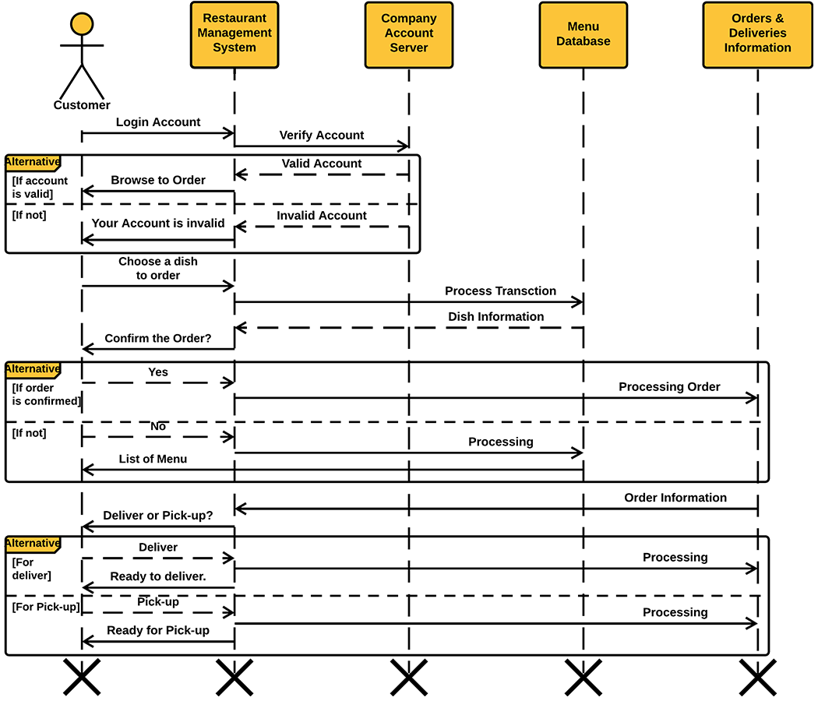
SEQUENCE DIAGRAM
LEARN MORE

Slide 11

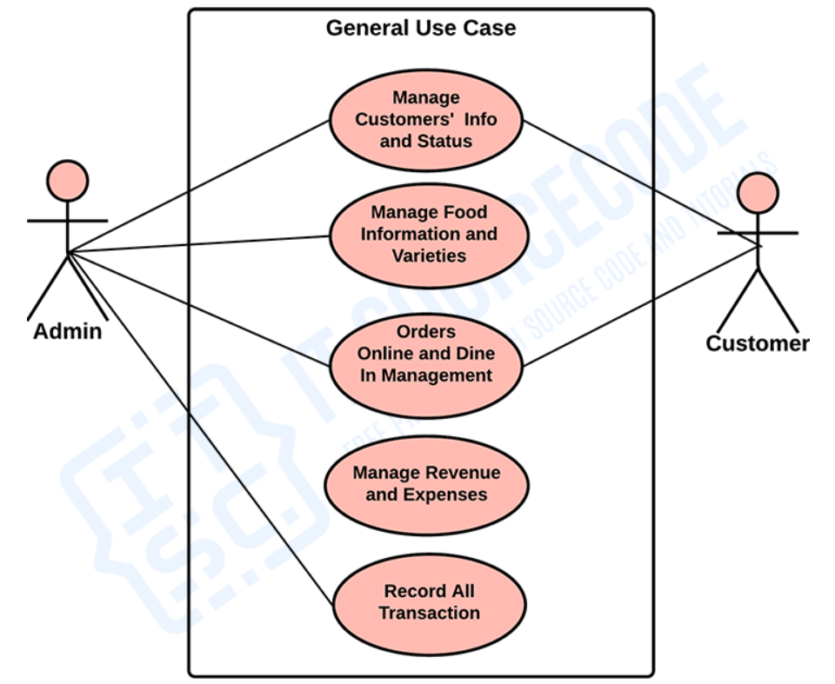
USE CASE DIAGRAM
LEARN MORE

Slide 12
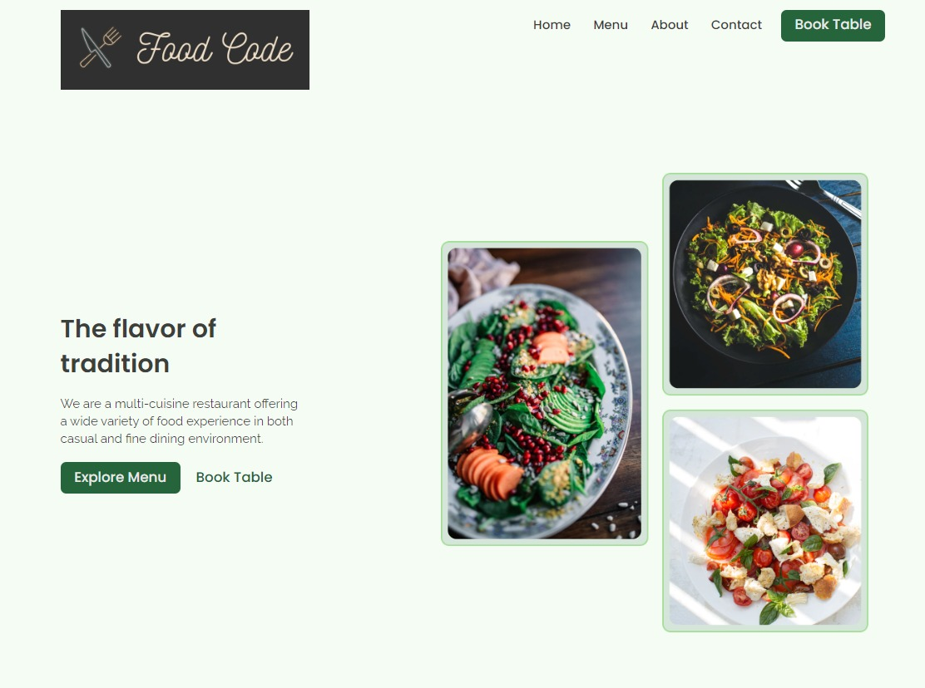
LEARN MORE

Slide 13
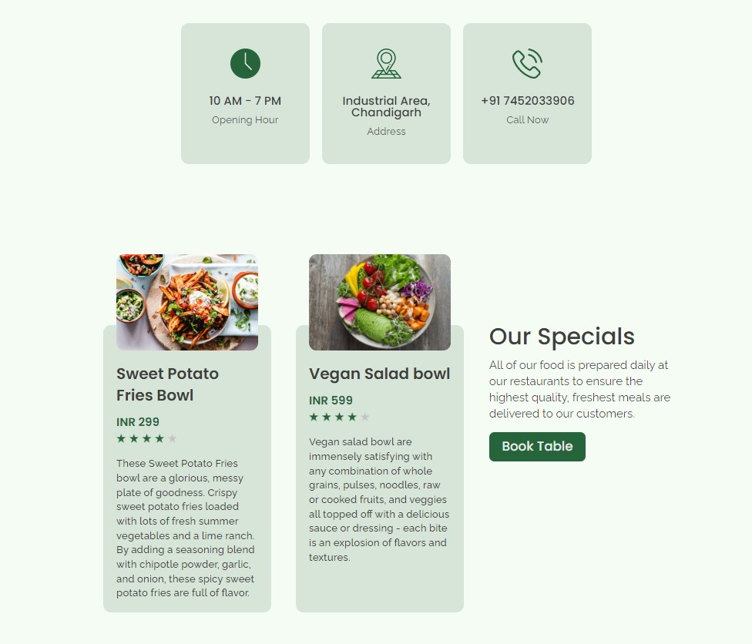
LEARN MORE

Slide 14
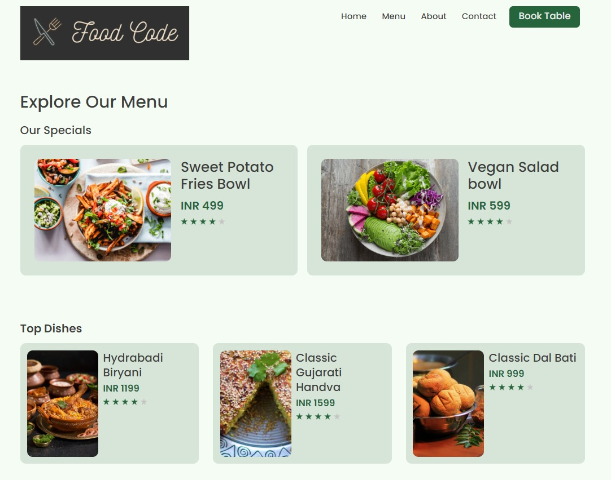
LEARN MORE

Slide 15
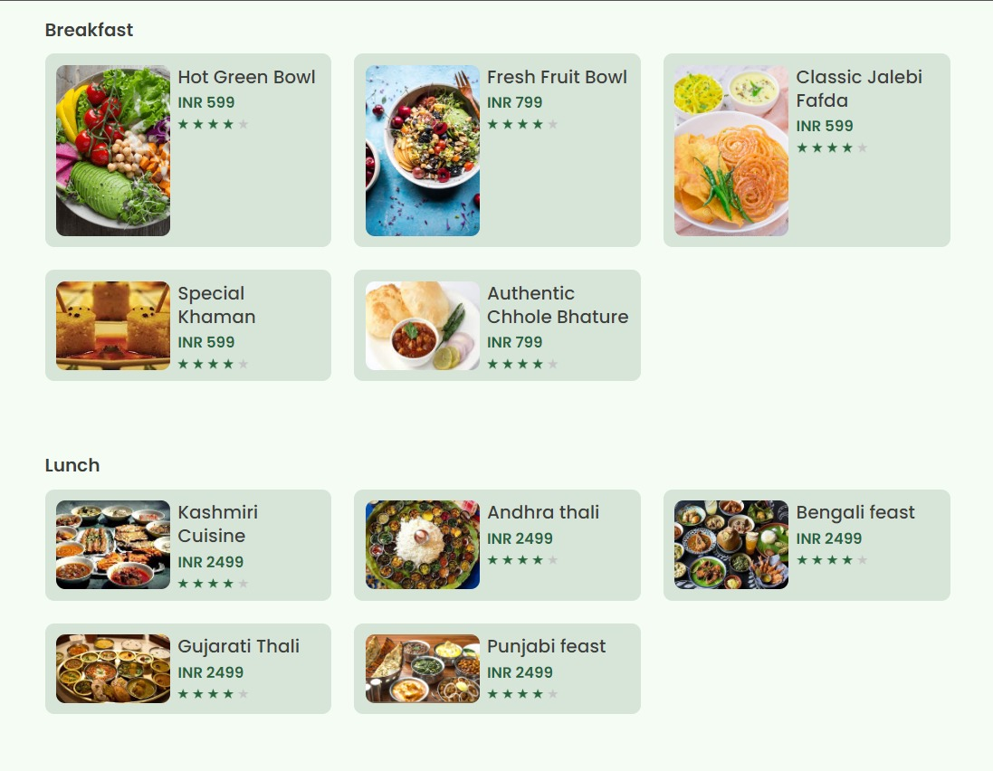
LEARN MORE

Slide 16
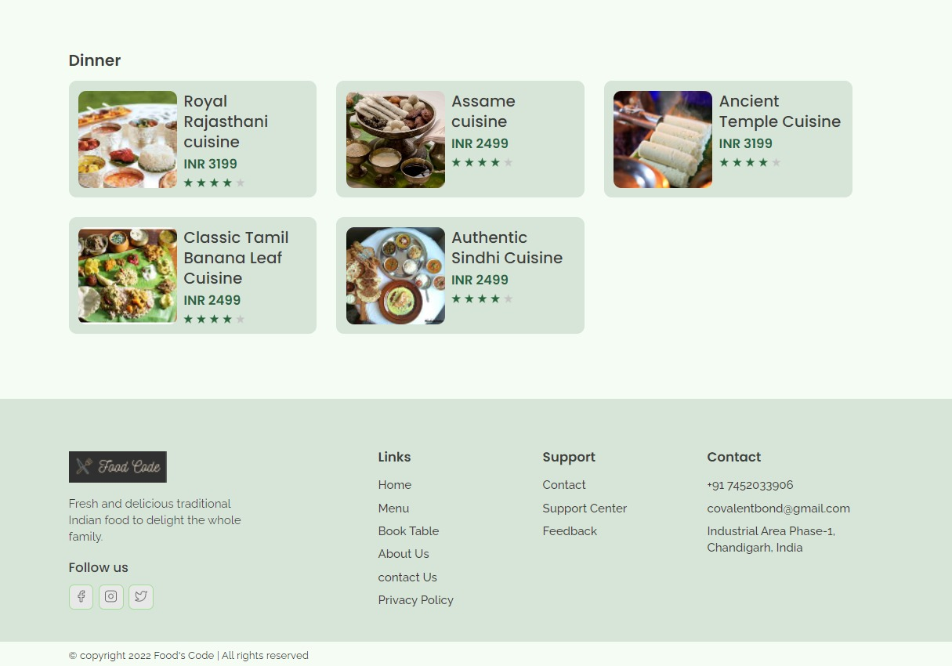
LEARN MORE

Slide 17
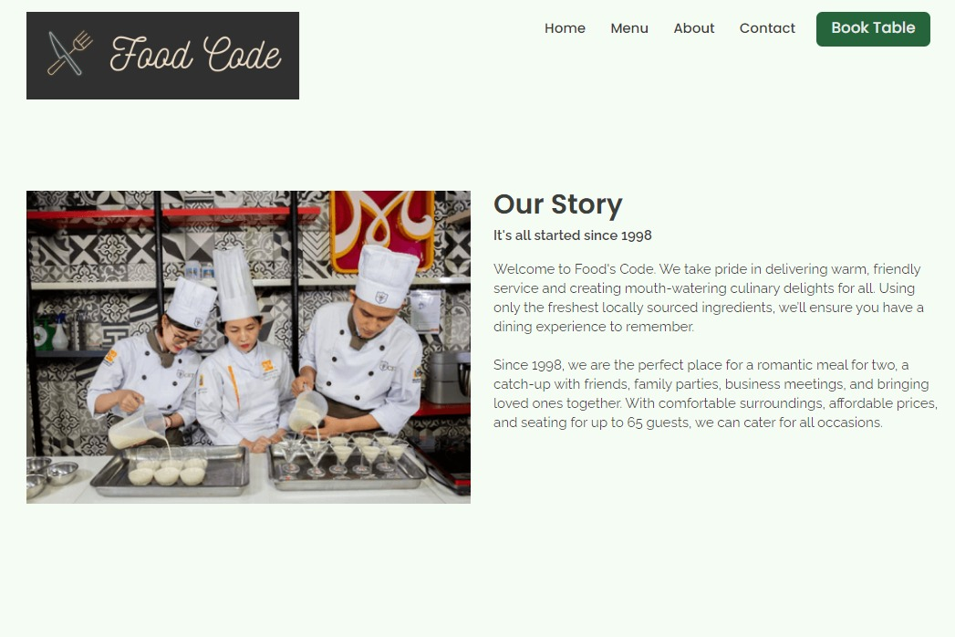
LEARN MORE

Slide 18
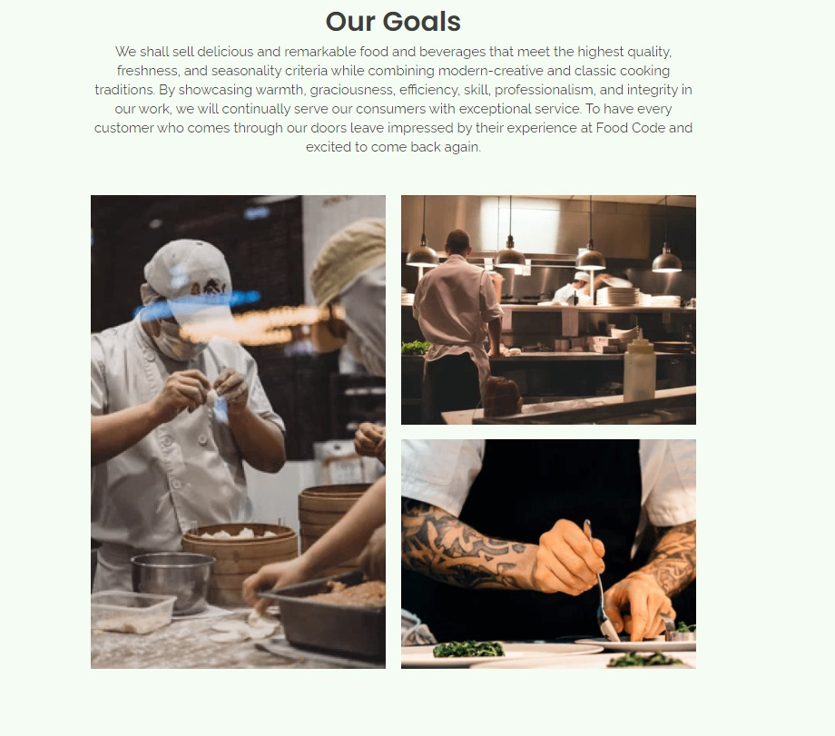
LEARN MORE

Slide 19
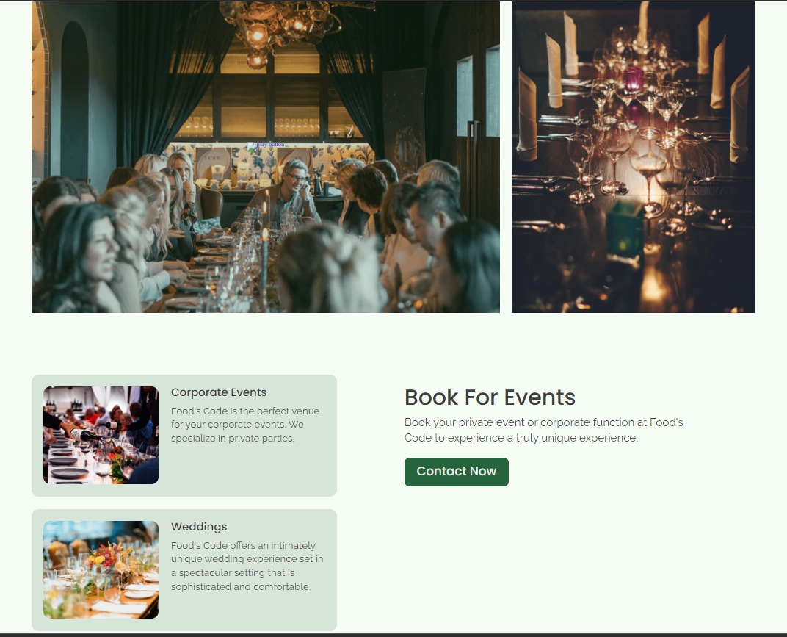
LEARN MORE

Slide 20
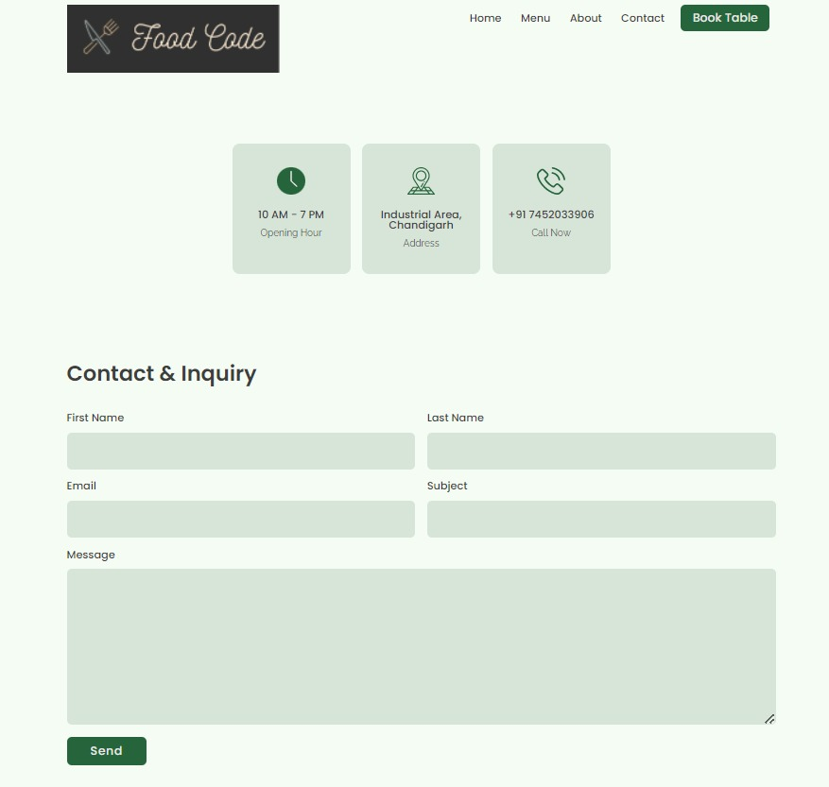
LEARN MORE

Slide 21
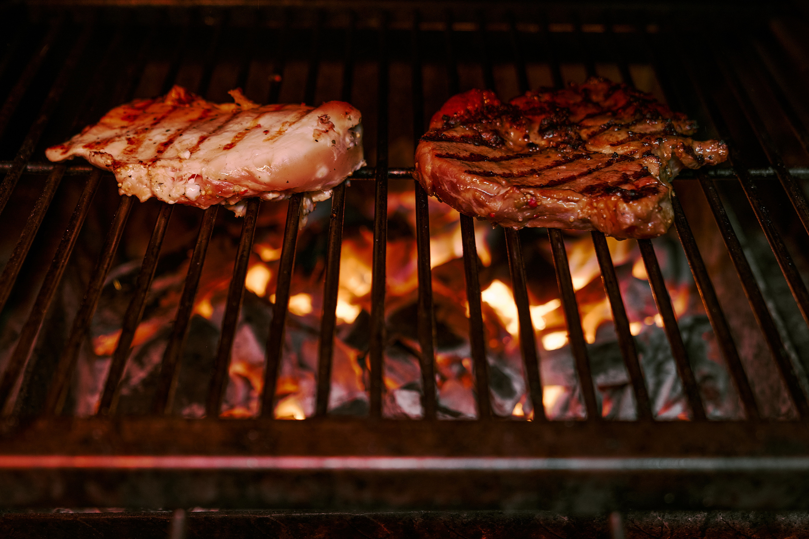
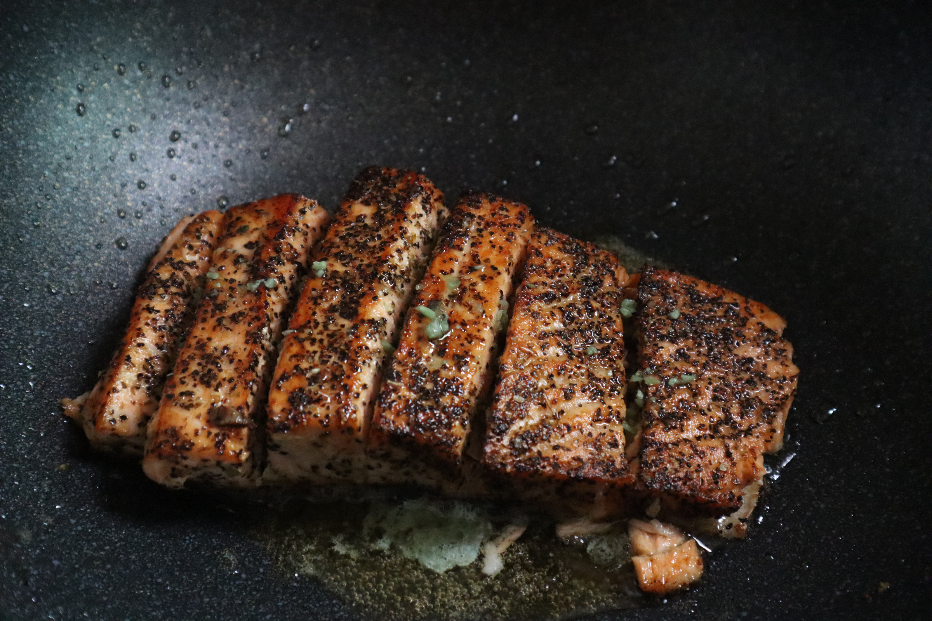


OUTCOMES
Improve Customer Relationships.
Tracking Sales.
Make digital network.
Hastle free management.
Enhanced Productivity.
Automatic Analysis.
ORDER NOW

Slide 22
REFRENCES
W3Schools
Javatpoint
Youtube
Tutorials point
ORDER NOW

Slide 23
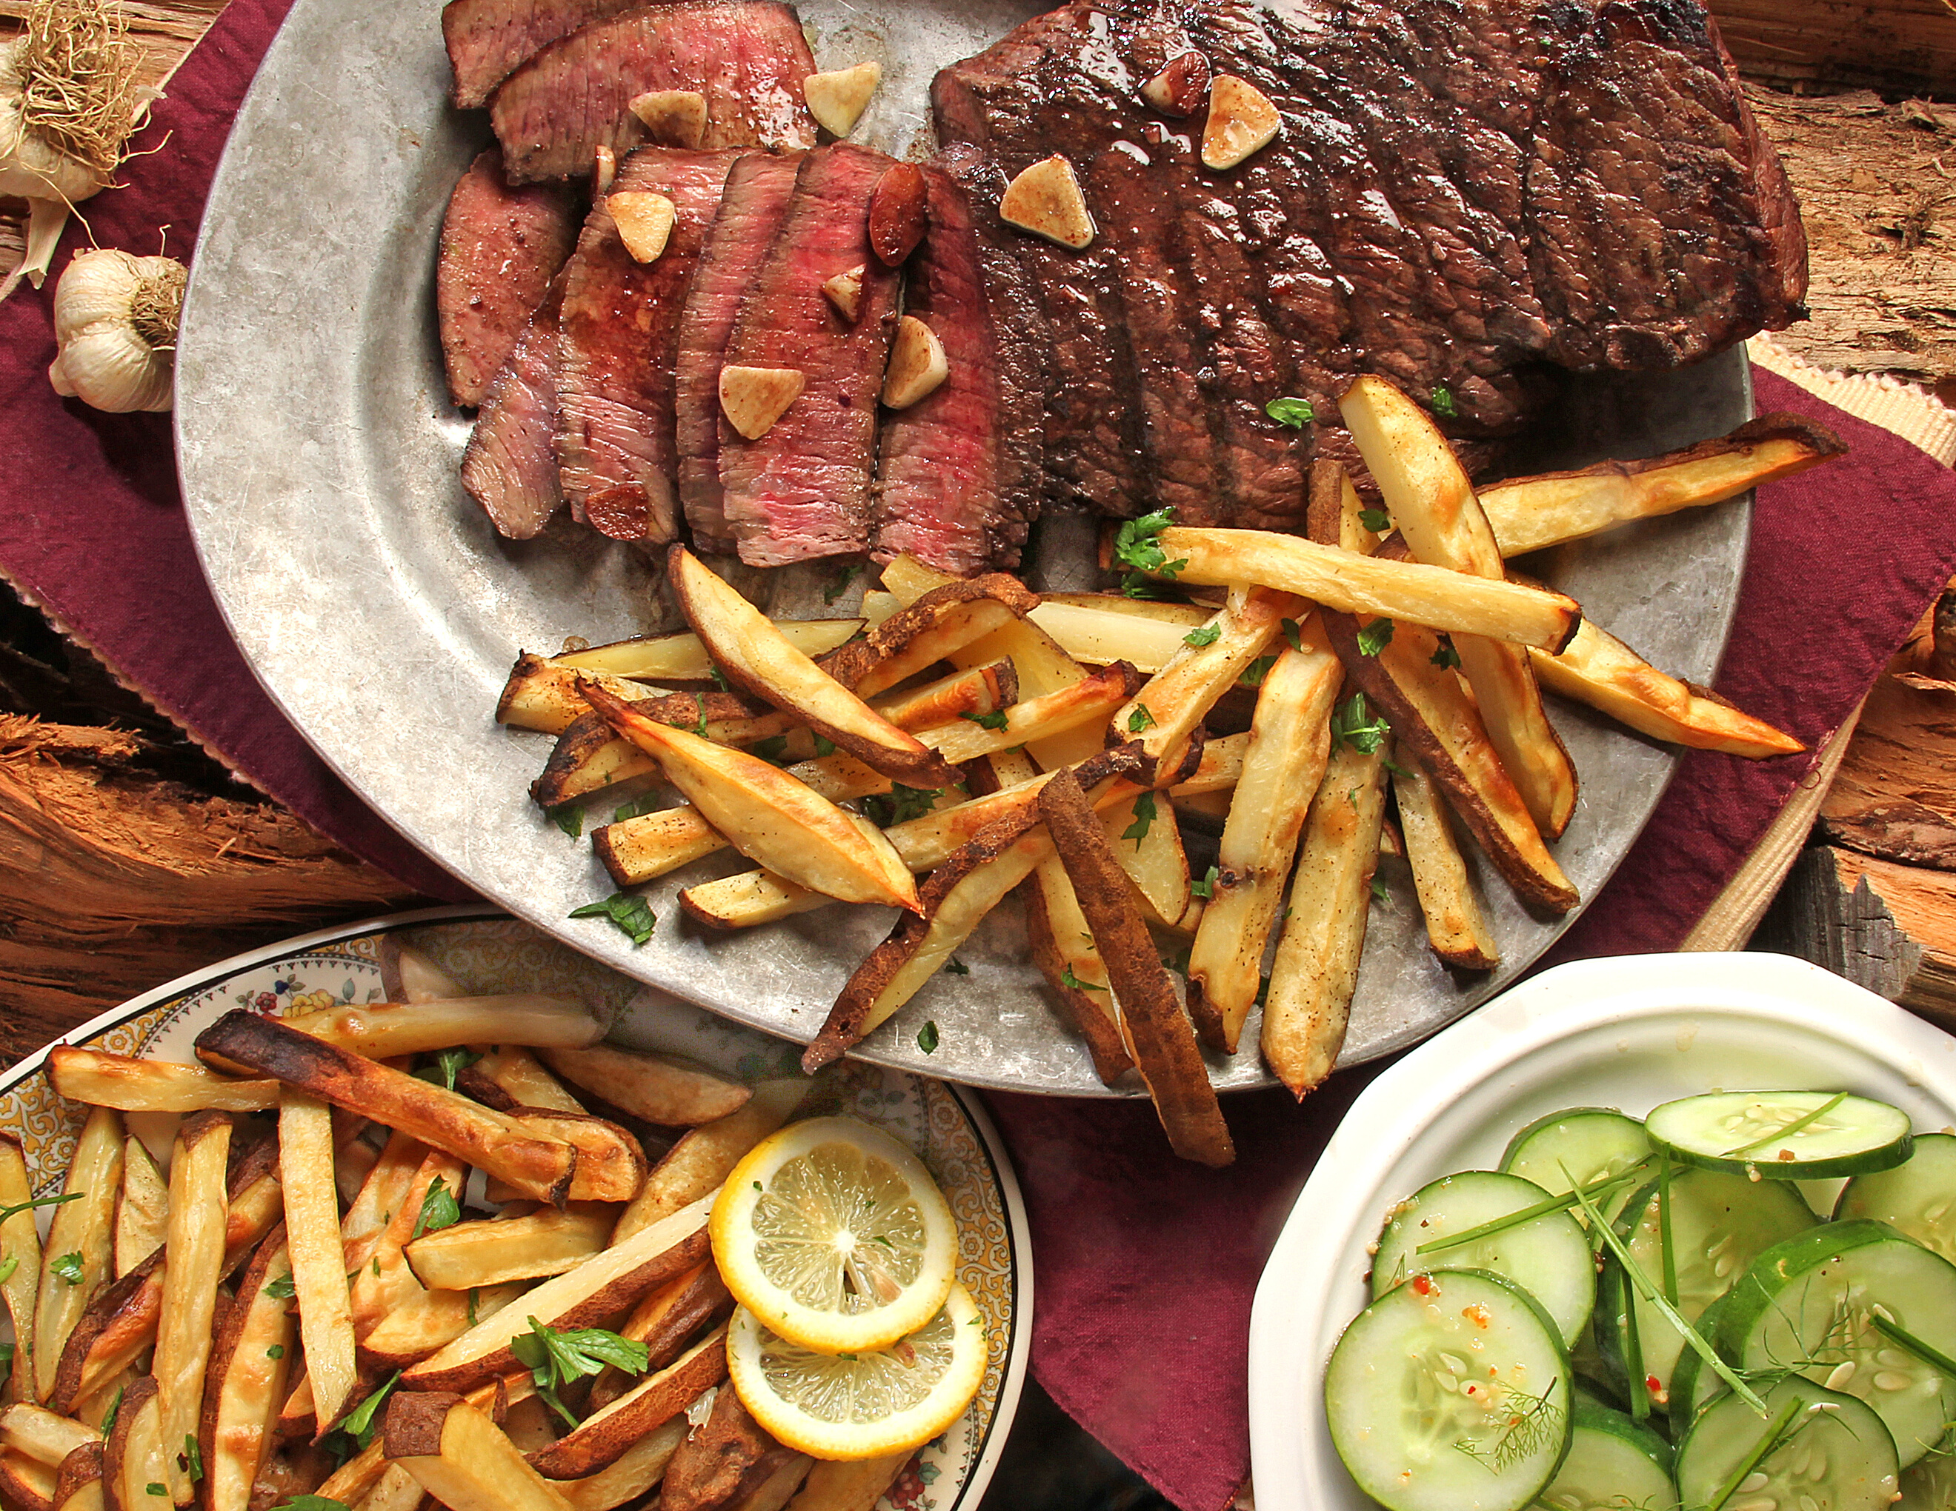
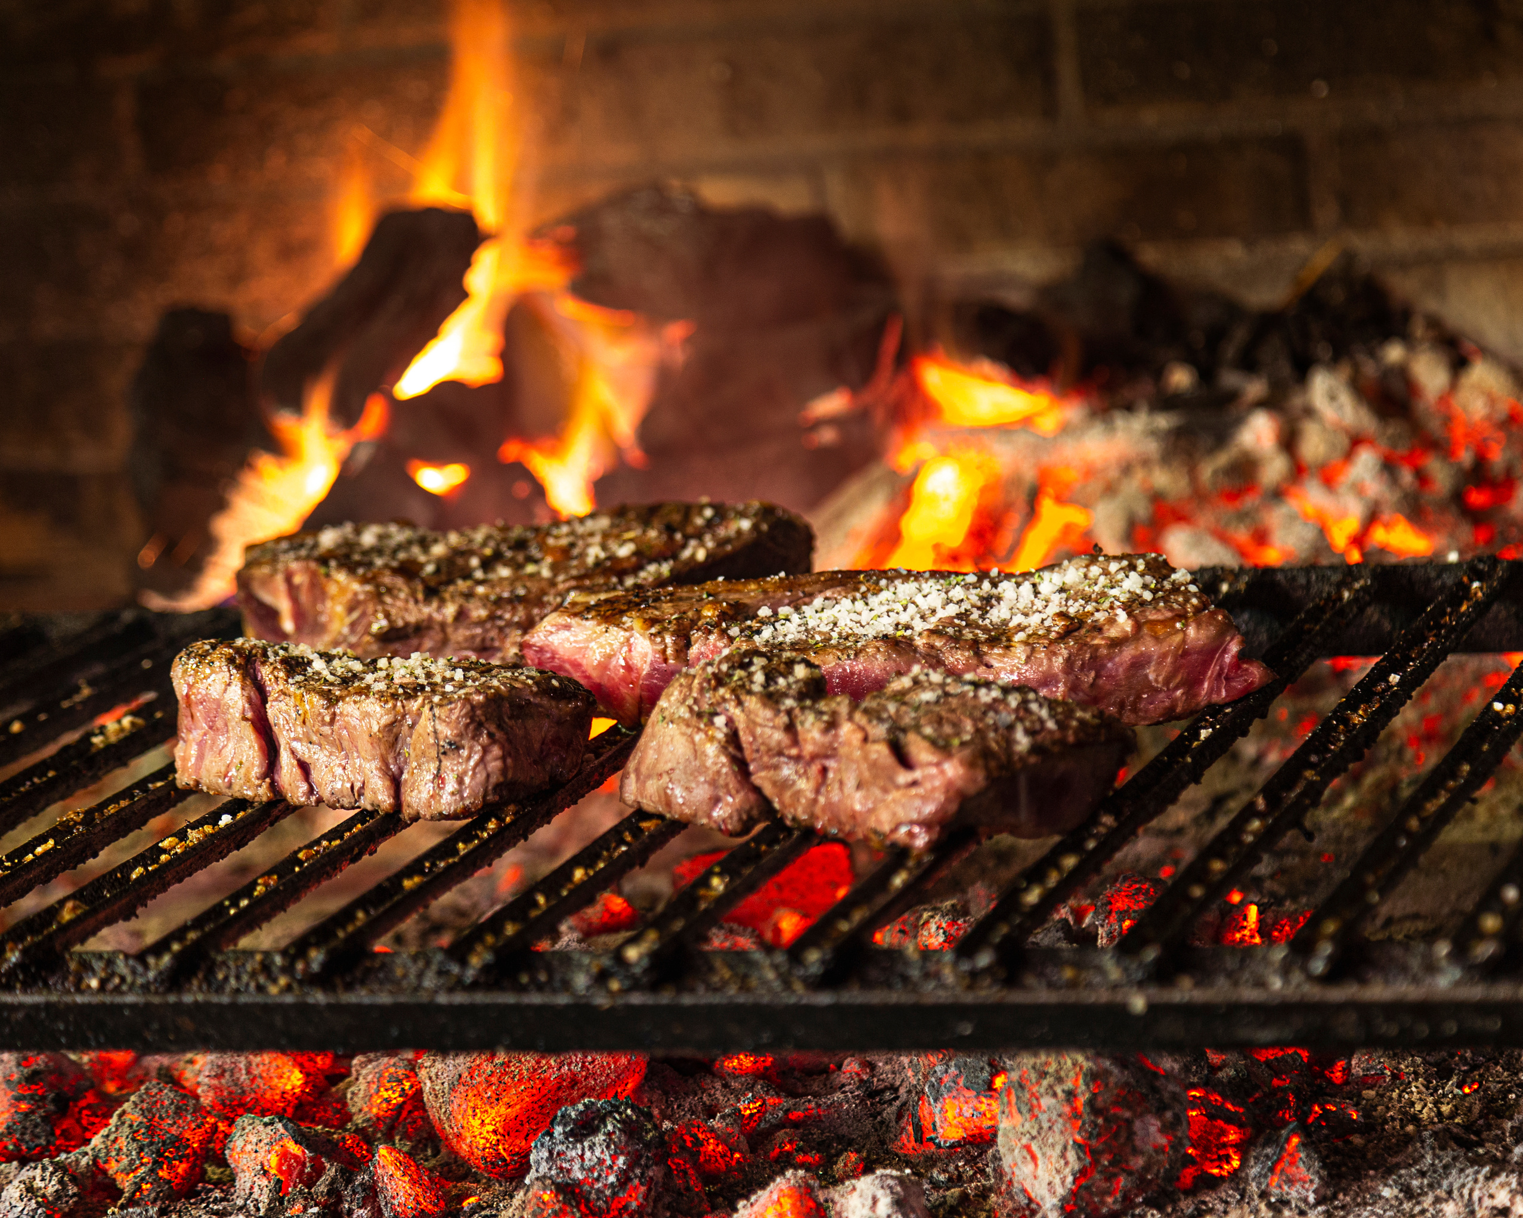
Thank You

